Slide 1
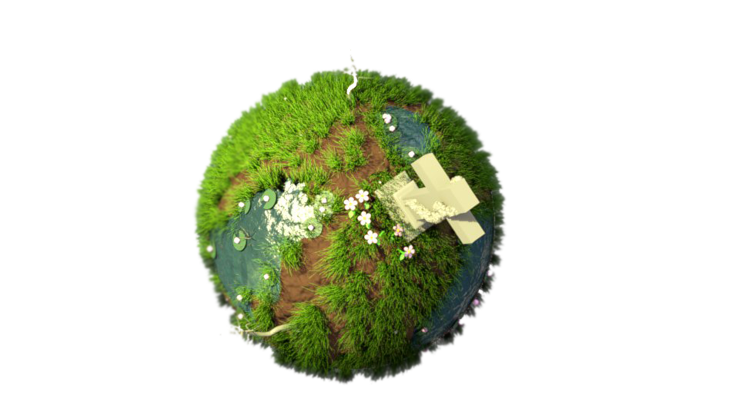
Regrowth

Slide 2
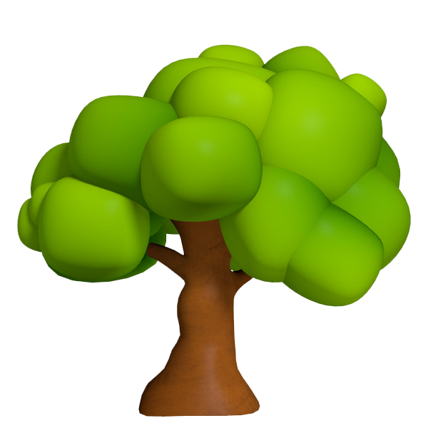

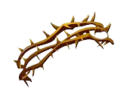
Concept
Re-vegetate the barren planet.
Remove the emerging weed vines.
Put out any fires.

Slide 3
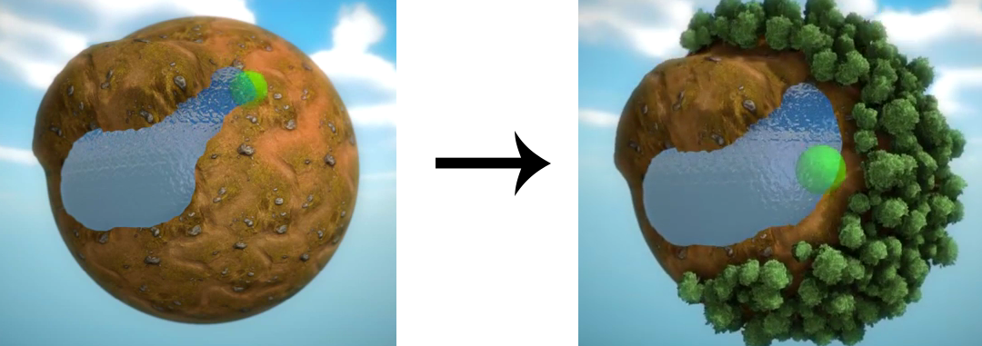
Re-vegetating
Seeds are planted > small sprout > tree.
Game is won after x trees are fully grown.
(Counter progress display)
Sprouts and trees can be destroyed by vines and fire.

Slide 4
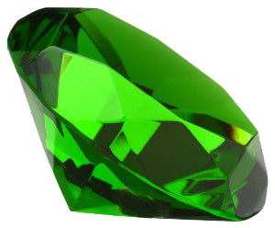

Vines appear constricting plants in range.
Vines can be removed with right click.
Removed vines may contain additional seeds.
Trees may randomly burst into flames and ignite nearby trees.
Fires are put out by filling your bucket at a water source and using it on a tree.

Slide 5
Controls
Rotate around planet – Move mouse to boundaries
Plant seed – Left click
Remove vine – Right click
Fill bucket / put out fire – Space bar while mouseover water/fire

Slide 6

Art style

Slide 7
